Slide 1
Arrays of Objects
Carole McGloughlin
Frances Sheridan

Slide 2
What is an Array of an object?
An array of primitive data is a powerful tool, but even more powerful is an array of objects.
By combining the power of arrays and objects, we can structure programs in a clean and logical organization.
If we have only arrays of primitives, then to represent a collection of Person or Account objects, for example, we need to use several different arrays, one for names, one for addresses, and so forth. This is very cumbersome and error-prone.
An array of Person objects or an array of Account objects will result in a more concise and easier-to-understand code

Slide 3
Arrays of objects!
Like primitive data types (int, double, boolean, etc) – we can have arrays of objects.
An array of objects is declared in the same way.
This declares an array of length 10 of object called objectName.
MyClass [] objectName;
objectName = new MyClass [10];

Slide 4
Assigning Values to An Array
An object might have more than one attribute, so assigning values to array of object is slightly more complicated.
Let’s continue with our Employee Example.
A basic Employee has a name and an empId number.
There are associated setter / getter methods.

Slide 5
Employee Class
public class Employee{ private String name;
private int empId;
public Employee(){
}
public void setEmpId(int empId){ this.empId = empId;
}
public void setName(String name){ this.name = name;
}
public int getEmpId(){ return empId;
}
public String getName(){ return name;
}
}

Slide 6
Employee Declaration
We will use the Employee class to illustrate the use of arrays of objects.
Let’s declare an Employee object and assign the values (Frank, 101) to it.
We access its data via its setter and getter methods.
Employee e = new Employee ();
e.setName(“Frank”);
e.setEmpId(101);
String name = e.getName();
int empID = e.getEmpId();

Slide 7
Creating an Array of Person Objects
Employee[ ] emp;
Now the array for storing 20 Employee objects is created, but the Employee objects themselves are not yet created.
emp
emp= new Employee[20];
person
0
1
2
3
4
16
17
18
19
State
of
Memory

Slide 8
Creating an Array of Person Objects
One Person object is created and the reference to this object is placed in position 0.
emp[0] = new Employee( );
person
0
1
2
3
4
16
17
18
19
State
of
Memory
Person

Slide 9
Processing Employee
In the same manner as we primitive arrays, we use loops to iterate through an array of objects.
Let’s say we want to allow the user to enter the name and empId to all 10 Employee objects
Scanner keyboard = new Scanner (System.in);
Employee [] emp = new Employee [10];
String name;
int empId;
for (int i=0; i<e.length; i++){ // 1. Read in Data
System.out.println(“Please Enter Name ”+i+“:”);
name = keyboard.nextLine();
System.out.println(“Please Enter Id ”+i+“:”);
// 2. Create Employee object
Employee e = new Employee ();
e.setName(name); // 3. Add details to single object.
e.setEmpId(empId);
emp[i] = e; // 4. Add object to array.
}

Slide 10
Accessing Data in Array of Objects
Similarly if we want to access the data stored in an array of objects (for example print out all of the details), we’d use a for loop:
For each element in the array, this will print out the name and empId.
for (int i=0; i<emp.length; i++){ Employee e = emp[i];
System.out.println(“Employee Name [” +i+“]: ”
+e.getName()+ “\n” +
“Employee ID [” +i+“]: ” + e.getEmpId());
}

Slide 11
Searching an Array
Search for employee whose id = 1034
Scanner keyboard = new Scanner (System.in);
Employee [] emp = new Employee [10];
String name;
int empId;
for (int i=0; i<e.length; i++){ // 1. Read in Data
System.out.println(“Please Enter Name ”+i+“:”);
name = keyboard.nextLine();
System.out.println(“Please Enter Id ”+i+“:”);
// 2. Create Employee object
Employee e = new Employee ();
e.setName(name); // 3. Add details to single object.
e.setEmpId(empId);
emp[i] = e; // 4. Add object to array.
}

Slide 12
Searching an Array
Let’s search for a particular employee.
We can scan through the array until the desired person is found.
Suppose we want to search for a employee whose name is Peter . If we assume the employee is in the array, then we can write
The expression emp[i].getName().equals(“Latte”) is equivalent to
int i=0;
while (!emp[i].getName().equals(“Peter Parker”)) { i++;
}
System.out.println(“Found Peter Parker at position ” + i);
Employee e = emp[i];
String str = e.getName();
str.equals(“Peter Parker”);

Slide 13
Deletion From an Array of Objects
There are a number of approaches to deleting an object from an array:
By setting the reference in its position to null.
By setting the reference in its position to the last person, so that there are no gaps in the array (and assuming the order in which the elements are in does not matter).
By shifting all of following data back so there are no gaps

Slide 14
Object Deletion – Approach 1
int delIdx = 1;
emp[delIdx] = null;
Delete Employee B by setting the reference in position 1 to null.
Before
emp
After
emp
0
1
2
3
0
1
2
3
A
B
C
D
A
C
D

Slide 15
Object Deletion – Approach 2
int delIdx = 1, last = 3;
emp[delIndex] = emp[last];
emp[last] = null;
Delete Employee B by setting the reference in position 1 to the last emp.
emp
Before
emp
After
0
1
2
3
0
1
2
3
A
B
C
D
A
D
C
Notes:
With the second approach, we divide the array into two parts: the first part contains the real
references and the second part contains the null references. When we delete a node, a hole will result and we must fill this hole.
There are two possible solutions. The first solution is to pack the elements. If an object at position J is removed (i.e., this position is set to null), then elements from position J+1 till the last non-null reference are shifted one position lower. And, finally, the last non-null reference is set to null. The second solution is to replace the removed element by the last element in the array. The first solution is necessary if the Person objects are arranged in some order (e.g., in ascending order of age). The second solution is a better one if the Person objects are not arranged in any order.

Slide 16
Object Deletion – Approach 3
Delete Employee B by shifting all remaining data back a position so there are no gaps.
emp
Before
emp
After
0
1
2
3
0
1
2
3
A
B
C
D
A
C
D
Notes:
With the second approach, we divide the array into two parts: the first part contains the real
references and the second part contains the null references. When we delete a node, a hole will result and we must fill this hole.
There are two possible solutions. The first solution is to pack the elements. If an object at position J is removed (i.e., this position is set to null), then elements from position J+1 till the last non-null reference are shifted one position lower. And, finally, the last non-null reference is set to null. The second solution is to replace the removed element by the last element in the array. The first solution is necessary if the Person objects are arranged in some order (e.g., in ascending order of age). The second solution is a better one if the Person objects are not arranged in any order.

Slide 17
Object Deletion – Approach 3
Approach 3 is more complicated and requires a second temporary array of the same size.
int delIdx = 1;
int len = emp.length;
int index = 0;
Employee [] temp = new Employee[len];
for (int i=0; i<delIdx; i++){
temp[index] = emp[i];
index ++;
}
for(int i=delIdx+1; i<emp.length; i++){
temp[index] = emp[i];
index ++;
}
temp[len-1] = null;
// now copy back to original array
emp = temp;

Slide 18
Worked Example – EmployeeApp
Step 1: Add a GUI to the EmployeeApp
Step 2: Add Functionality behind the GUI
Step 3: Add an array of objects
Step 4: Set our GUI class to visible

Slide 19
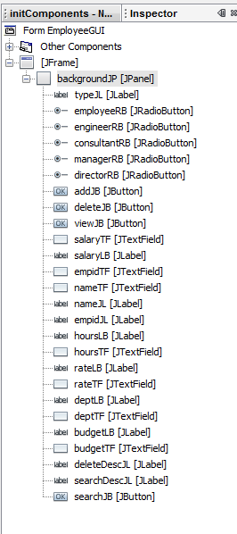
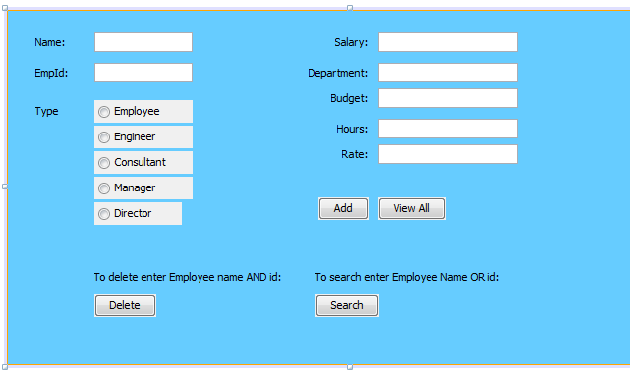
Step 1: Add a GUI to the EmployeeApp
Add the following GUI to include:
10 Jlabels, 7 JTextFields, 4 JButtons and 5 JradioButtons (renamed appropriately and labelled appropriately).

Slide 20
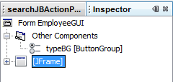
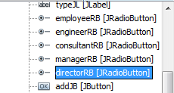
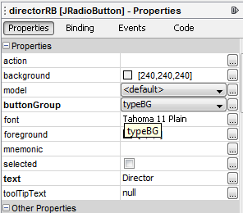
Step 1: contd - ButtonGroups
Add a JButtonGroup to the GUI (drag and drop) – this will look invisible on the GUI and appears in the Inspector tab under entitled Other Components
Change the variable name of the Button Group.
Click on each of the JRadioButtons in turn and in the properties tab, add to the JButtonGroup

Slide 21
Step 2: Add Functionality behind the GUI
Set initial layout – we only want name, empid and the radio button group to show.
Put functionality behind each of the radio buttons – corresponding to the employee type.
Put functionality behind each of the Add, View All, Delete and Search Buttons.

Slide 22
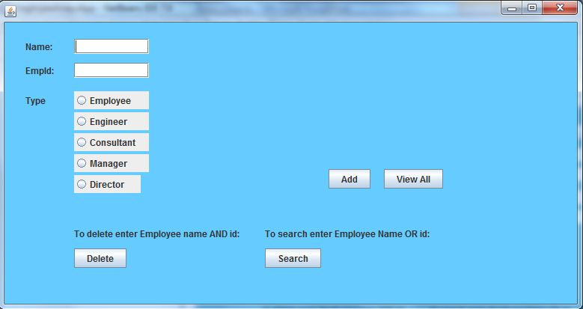
Step 2: Initial Layout
Only name and empid Jlabels and JTextFields, all the JRadiobutton and the Jbuttons should be visible.
The rest are set to invisible in the class constructor.
For example,
salaryTF.setVisible(false);
salaryLB.setVisible(false);

Slide 23
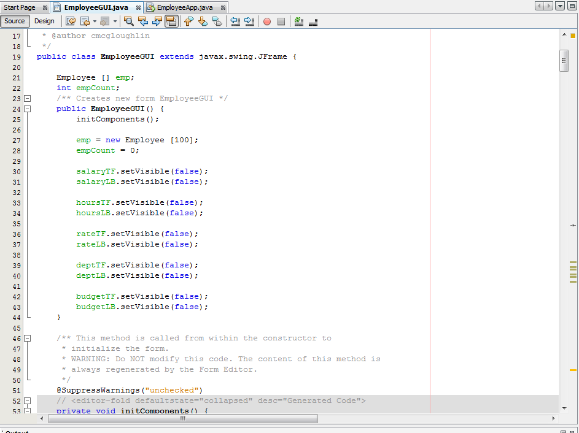
Step 2: Initial Layout
The constructor in the EmployeeGUI class will look something like this:

Slide 24
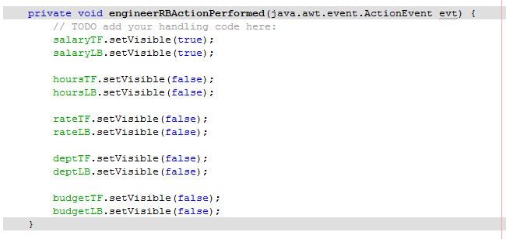
Step 2: JRadioButtons Functionality
When each JRadioButton is clicked we want the corresponding information , etc information to be set to Visible.
For example, an Engineer has the additional field salary, so we want to set the salary JLabel and JTextField to visibility to true and the rest of the additional Jlabels and JTextFields visibility to false.
salaryTF.setVisible(true);
salaryLB.setVisible(true);

Slide 25
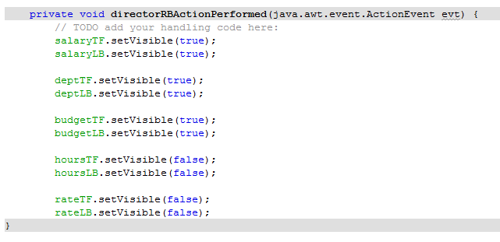
Step 2: JRadioButtons Functionality
When each JRadioButton is clicked we want the corresponding information , etc information to be set to Visible.
For example, a Director has the additional field salary, dept and budget, so we want to set all of their JLabel and JTextField visibility to true and the rest of the additional Jlabels and JTextFields visibility to false.

Slide 26
Step 3 – Add the Employee array
Add the Employee array at the top of the program
Add an additional variable empCount, to keep track of how many Employee have been entered.
In the constructor add the following line of code to construct the array to be of size 100 (that is, we can add a maximum of 100 employees.
public class EmployeeGUI extends javax.swing.JFrame {
Employee [] emp;
int empCount;
…
}
public EmployeeGUI() {
…
emp = new Employee [100];
empCount = 0;
…
}

Slide 27
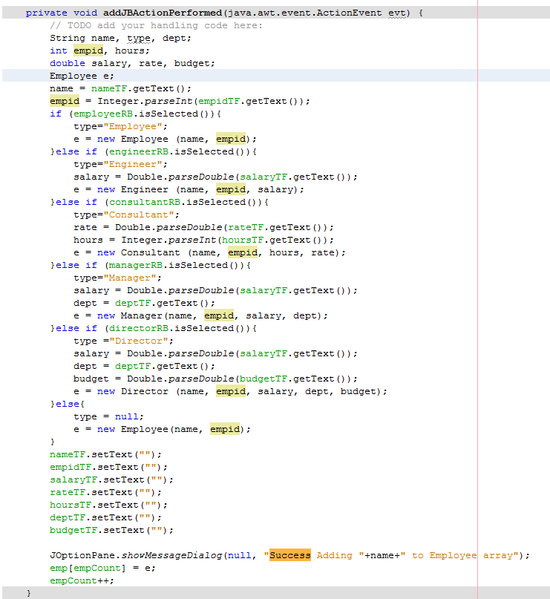
Step 2/3 – Functionality behind Add Button
The add button allows us add an employee to our employee array emp.
Get the name and empid from the appropriate JTextFields
Check to see which radio button was selected
Grab remaining information according to which radio button was selected.
Create a new temp Employee object, constructed to appropriate class and add information to this object.
Re-set all the textfields to be blank.
Add the temp employee object to the employee array.
Increment the empCount.

Slide 28
Step 2/3 – Functionality behind ViewAll Button
The ViewAll button allows us to view ALL of the employee saved in our Employee Array. Each Employee is outputted in a JOptionPane window. When the button is clicked the following should happen:
Declare a temporary Employee object called e.
Iterate through the Employee array (emp) using empCount.
Set the temporary Employee object equal to the current Employee object in the array.
Get the name and empid from the object e.
Check to see what type of Employee we are looking at (using the instanceof keyword) and grab the relevant information.
Output all information for particular Employee using JOptionPane.

Slide 29
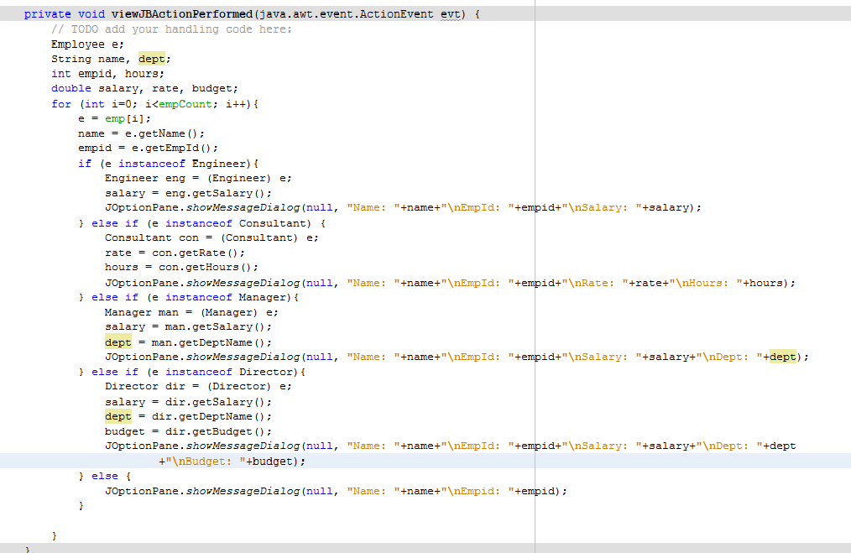
Step 2/3 – Functionality behind ViewAll Button

Slide 30
Step 2/3 – Functionality behind Search Button
The Search button allows us to serach for a particular Employee in the Employee array output their details in a JOptionPane window. When the button is clicked the following should happen:
Declare a temporary Employee object called e.
Grab the name and empid from the relevant JTextField.
If neither have been set, show an error and bring user back to page.
If name or empid has been set, then iterate through Employee array until either the name in the JTextField matches the name in the array, or the empid in the JTextField matches the empid in the array.
Check to see what type of Employee we are looking at (using the instanceof keyword) and grab the relevant information.
Output all information for particular Employee using JOptionPane.

Slide 31
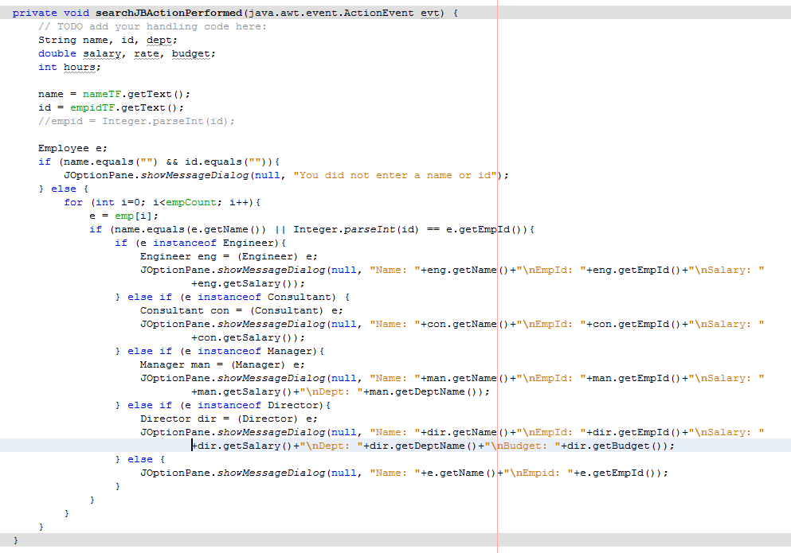
Step 2/3 – Functionality behind Search Button

Slide 32
Step 2/3 – Functionality behind Delete Button
The Delete button allows us to delete a particular Employee in the Employee array. When the button is clicked the following should happen:
Declare a temporary Employee object called e.
Grab the name and empid from the relevant JTextField.
If both have not been set, show an error and bring user back to page.
If both name and empid have been set, then iterate through Employee array until both the name in the JTextField matches the name in the array, and the empid in the JTextField matches the empid in the array.
Set the Employee in question emp[i] to equal the last Employee in the array emp[empCount-1].
Decrement the empCount by 1.
Output a message saying “Successful Deletion” and break out of the loop.

Slide 33
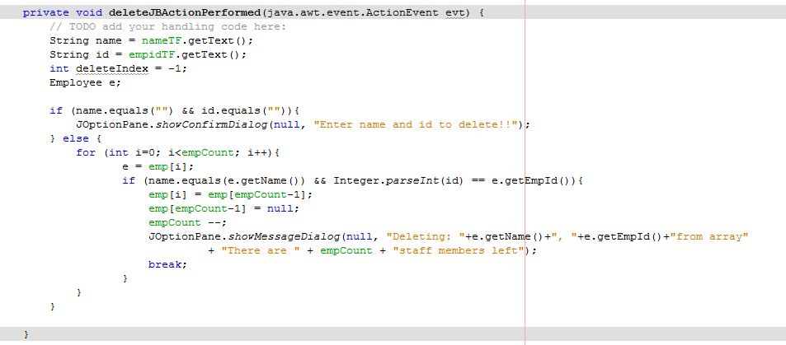
Step 2/3 – Functionality behind Delete Button

Slide 34
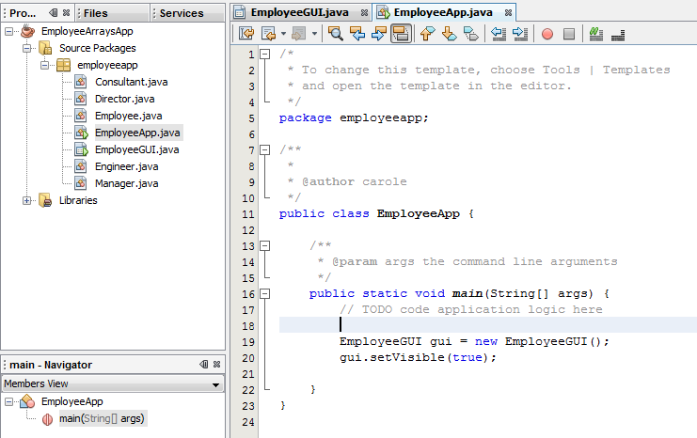
Step 4: Set GUI class to Visible
In the Main class in the main method, declare and create our GUI object.
Set this object’s visibility to be true.

